Slide 1
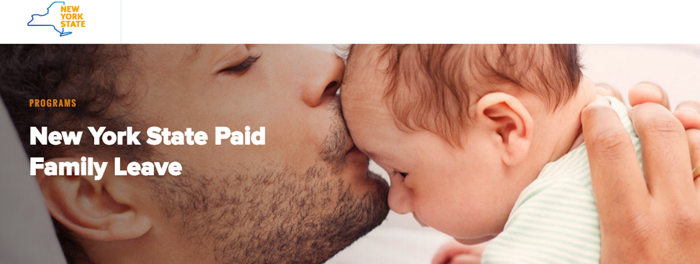

Slide 2
Law, regulations, and policy within the context of my research
Research and census data show that women exit high level leadership positions at greater rates than their male counterparts. Likewise, women represent more than half of middle-management positions yet are underrepresented at the highest levels representing less than 15 % of executive positions and only 6% of top earner positions.
One of the variables most highly correlated in the research with women’s turnover, intent to quit, and career slow-tracking is motherhood. This makes family leave law and policy highly salient in any advocacy work related to advancing women in organizational leadership.
LENS:
Advocacy Coalition Framework (ACF)
Feminist Critical Theory
Postmodern/Deconstructivist
Ecological (Assessment/Accountability)

Slide 3
FMLA versus New York Paid Family Leave Benefits Law (PFLBL)
The Family and Medical Leave Act of 1993 (FMLA) is a United States federal law requiring covered employers to provide employees job-protected and unpaid leave for qualified medical and family reasons.
The PFLBL is a series of amendments to the New York State Workers’ Compensation Law. When the amendments are fully phased in, covered employees will be eligible for up to 12 weeks of paid family leave annually to care for an infant or a family member with a serious health condition…
Most organizational policies mirror the law

Slide 4
Limitations: Policy = Law?
SBU - Family Leave Policy (Employee Handbook)
To be eligible for FMLA leave, an employee must: 1) have worked for St. Bonaventure University (“University”) for at least twelve (12) months; and 2) have worked at least 1,250 hours during the twelve (12) month period immediately preceding commencement of the leave. Determination of whether an employee has met both the twelve (12) month and 1,250-hour requirements will be made as of the date that the leave is to commence.
Leave Entitlement 1) The University will grant an eligible employee up to a total of twelve (12) workweeks of unpaid leave during any twelve (12) month period for one or more of the following reasons: a) the birth and care of the employee’s newborn child; b) the placement of a child with the employee for adoption or foster care; c) to care for an immediate family member (spouse, child or parent, but not parent-in-law) with a serious health condition; or d) the employee’s own serious health condition that prevents him/her from performing the functions of his/her position.

Slide 5
FMLA versus NY PFLBL
FMLA | PFLBL
Up to 12 weeks unpaid | 12 weeks paid
Companies with over 50 employees eligible | Applies to all employers without regard to the employer's number of employees
Employees are eligible to take FMLA leave if they have worked for their employer for at least 12 months, and have worked for at least 1,250 hours over the previous 12 months | Employed by their employer for at least 26 or more consecutive weeks preceding the beginning of leave
The birth of a child and to care for the newborn child within one year of birth; caring for the Eligible Employee's family member with a serious health condition | SAME
N/A | Paid by a state fund – not their employers
Have worked for at least 1,250 hours within the previous 12-month period | No minimum hours requirement

Slide 6
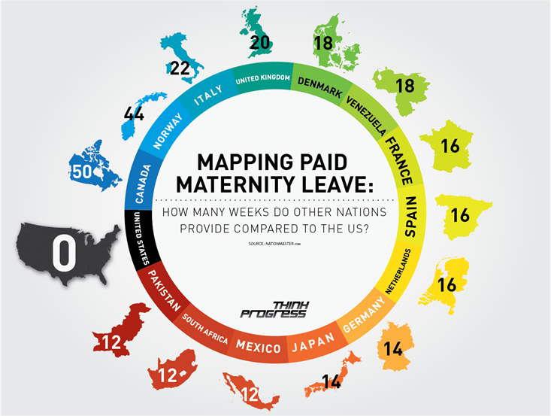
Timely!

Slide 7
When fully phased in, NY will have the longest and most comprehensive paid family leave program in the nation

Slide 8
Assessment: Access versus Use of Benefit
Policy Implications/Limitations: Law is not enough!
What is being assessed, is it appropriate, and by whom?

Slide 9
Ecological Assessment Framework (Stakeholders)
“Paid parental leave and subsidized child-care
help to get and keep more women in the workforce, contribute to economic growth and offer cognitive and
health benefits to children” (Adema, Clark & Frey, 2016, p. 49)
“As long as women’s transitions out of the workforce are seen as personal, little will likely be done to remedy the situation” (Prilleltensky & Prilleltensky, 2006, p. 38).
Adema, W., & Frey, V. (2016) Paid parental leave and other supports for parents with young children: The United States in international comparison. International Social Security Review, 69(2), 29-51. doi:10.1111/issr.12100
Prilleltensky, I., & Prilleltensky, O. (2006) Promoting well-being: Linking personal, organizational, and community change. John Wiley and Sons, Hoboken, NJ

Slide 10
Research (Society)
Equity (power, hegemony)
Social Justice
Benevolent Citizenry
Altruistic, socially conscious society
Promoting social justice and equity in the workforce requires a social and ecological perspective (Prilleltensky & Prilleltensky, 2007).

Slide 11
Research (Organization)
Economic Outcomes; increased employee retention and decreased turn-over;
Values/Mission (walk the talk)
Diversity Initiatives
Kistler, L. H., & McDonough, C. C. (1975). Paid Maternity Leave: Benefits May Justify the Cost. Labor Law Journal, 26(12), 782-794.
Dahl, G. B., Løken, K. V., Mogstad, M., & Vea Salvanes, K. (2016). What is the case for paid maternity leave? Review Of Economics & Statistics, 98(4), 655-670. doi:10.1162/REST_a_00602

Slide 12
Research (Individual/worker)
Monetary
Mental Health
Professional Capital
Aisenbrey, S., Evertsson, M., & Grunow, D. (2009). Is There a Career Penalty for Mothers' Time Out? A Comparison of Germany, Sweden and the United States. Social Forces, 88(2), 573-605.
Aitken, Z., Garrett, C. C., Hewitt, B., Keogh, L., Hocking, J. S., & Kavanagh, A. M. (2015). The maternal health outcomes of paid maternity leave: A systematic review. Social Science & Medicine, 13032-41. doi:10.1016/j.socscimed.2015.02.001
Dagher, R. K., McGovern, P. M., & Dowd, B. E. (2014). Maternity Leave Duration and Postpartum Mental and Physical Health: Implications for Leave Policies. Journal Of Health Politics, Policy & Law, 39(2), 369-416. doi:10.1215/03616878-2416247f

Slide 13
Research (Child)
Academic Outcomes
Health Outcomes
Rasmussen, A. W. (2010). Increasing the length of parents' birth-related leave: The effect on children's long-term educational outcomes. Labour Economics, 17(1), 91-100. doi:10.1016/j.labeco.2009.07.007
Qian, L., & Skans, O. N. (2010). The Duration of Paid Parental Leave and Children's Scholastic Performance. B.E. Journal Of Economic Analysis & Policy: Contributions To Economic Analysis & Policy, 10(1), 1-33.
Carneiro, P., Løken, K. V., & Salvanes, K. G. (2015). A Flying Start? Maternity Leave Benefits and Long-Run Outcomes of Children. Journal Of Political Economy, 123(2), 365-412.

Slide 14
Policy Assessment Recommendations:
Close the Assessment Loop
Accountability
Law
Policy
Goals
Assessment
Accountability
Law – Board, Executive Team, HR
Policy – Senior Management, HR
Goals (assessment and accountability) – Senior Management, HR, Department Managers, Individual Employees

Slide 15
Culture trumps strategy…
Regarding Mission/Values/Goals - “Culture trumps strategy every time” (Bustin, p. 27)
Regarding Unity - “Every employee understands and supports the organizations mission, vision, values, and strategy and knows his or her role in helping to achieve them” (Bustin p. 33)
Regarding Communications - Evans and Foster (2014) “Certain language projects failure” (p. 135); “ambiguity is the problem and specificity is the solution” (p. 184)

Slide 16
Recommendations
Tie Policy to Goal Setting
In the language of organizational goal setting
Same process as financial goal setting
Who, What, When, Why?
Reward tied to outcome

Slide 17
References
Adema, W., Clarke, C., & Frey, V. (2016). Paid parental leave and other supports for parents with young children: The United States in international comparison. International Social Security Review, 69(2), 29-51. doi:10.1111/issr.12100
Aitken, Z., Garrett, C. C., Hewitt, B., Keogh, L., Hocking, J. S., & Kavanagh, A. M. (2015). The maternal health outcomes of paid maternity leave: A systematic review. Social Science & Medicine, 13032-41. doi:10.1016/j.socscimed.2015.02.001
Bustin, G. (2014). Accountability: The key to driving a high-performance culture. New York, NY: McGraw Hill
Carneiro, P., Løken, K. V., & Salvanes, K. G. (2015). A Flying Start? Maternity Leave Benefits and Long-Run Outcomes of Children. Journal Of Political Economy, 123(2), 365-412.
Carter, N. M., & Silva, C. (2010, March). Women in management: Delusions of progress. Catalyst. Accessed from http://hbr.org/2010/03/women-in- management-delusions-of-progress/ar/1
Catalyst. (2011, August). Women leaving & re-entering the workforce. Accessed from http://www.catalyst.org/publication/249/women-leaving-re- entering-the-work-force.
Dagher, R. K., McGovern, P. M., & Dowd, B. E. (2014). Maternity Leave Duration and Postpartum Mental and Physical Health: Implications for Leave Policies. Journal Of Health Politics, Policy & Law, 39(2),369-416. doi:10.1215/03616878-2416247f
Dahl, G. B., Løken, K. V., Mogstad, M., & Vea Salvanes, K. (2016). What is the case for paid maternity leave? Review Of Economics & Statistics, 98(4), 655-670. doi:10.1162/REST_a_00602Aisenbrey, S.,Evertsson, M., & Grunow, D. (2009). Is There a Career Penalty for Mothers' Time Out? A Comparison of Germany, Sweden and the United States. Social Forces, 88(2), 573-605.
Evans, H. & Foster, C. (2014). Step up: Lead in six moments that matter. San Francisco, CA: Wiley
Kistler, L. H., & McDonough, C. C. (1975). Paid Maternity Leave: Benefits May Justify the Cost. Labor Law Journal, 26(12), 782-794.
Prilleltensky, I., & Prilleltensky, O. (2006) Promoting well-being: Linking personal, organizational, and community change. John Wiley and Sons, Hoboken, NJ
Qian, L., & Skans, O. N. (2010). The Duration of Paid Parental Leave and Children's Scholastic Performance. B.E. Journal Of Economic Analysis & Policy: Contributions To Economic Analysis & Policy, 10(1), 1-33.
Rasmussen, A. W. (2010). Increasing the length of parents' birth-related leave: The effect on children's long-term educational outcomes. Labour Economics, 17(1), 91-100. doi:10.1016/j.labeco.2009.07.007
United States Census Bureau (2009). Women in the Workforce. Retrieved March 6, 2106 from https://www.census.gov/newsroom/pdf/women_workforce_slides

