Slide 1
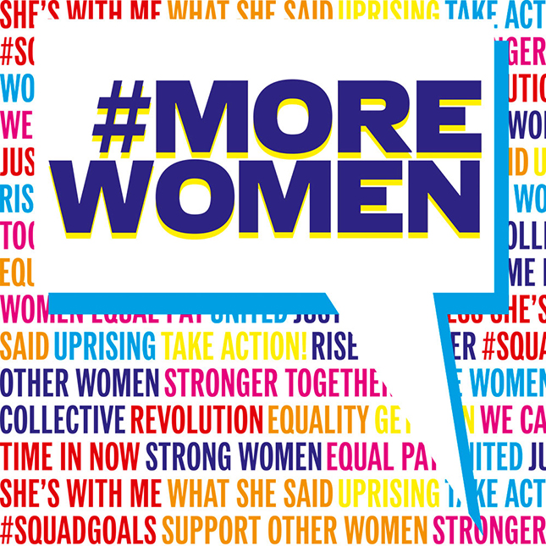
Where are the women?
Understanding women’s underrepresentation at
the highest echelons of corporate leadership
Kimberly DeSimone
April 29, 2017

Slide 2
Ontology
Feminist Economics
Post-Structuralism
Power Distance
Vertical/Occupational Segregation
Epistemology
Post-Modernism
Deconstructivism
Enactment
Hegemony/Hierarchy
Axiology
Feminist Framework
Androcentric Bias
Male Centered Work Ethos
Key Theories
Post-Modernism/Enactment
Ecological
Gender Socialization Theory
Key Variables
Underrepresentation of Women in Power Positions
Push Variables
Pull Variables
Research Lens

Slide 3
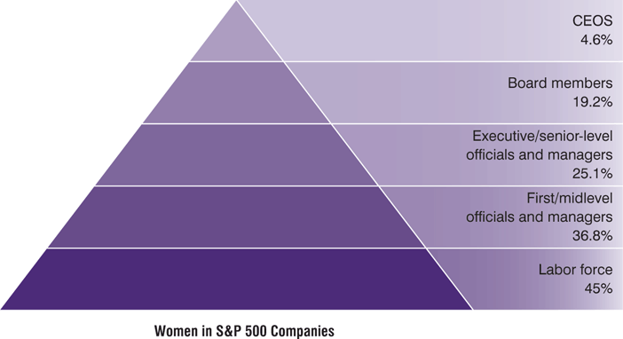
PROBLEM STATEMENT
The corporate pipeline for women is broken!
Despite women’s equal representation in the workplace they are underrepresented in the upper echelons of organizations with women representing only 13% of Fortune 500 executive officers, 7.5% of corporate top earners, and 3.6% in the role of CEO (Catalyst, 2011).
This is a problem because Fortune 500 companies with the best records of promoting women outperform their counterparts anywhere from 50 to 100 percent in terms of higher financial returns and overall earnings (Adler, 2009).
Likewise, women’s underrepresentation and often subsequent exit from the workforce has significant and lasting consequences on women’s economic status over the long-term (Williams, Manvell, and Bornstein’s, 2006).

Slide 4
Purpose of the Study
This study will aim to better understand what women perceive to be the barriers in reaching executive level, top earner corporate management positions.
The literature reveals a complex symphony of push and pull variables which influence women’s decisions to remain, slow-track, or exit the workforce.
Lack of consensus in the literature regarding causal explanations for women’s disproportionately high workforce quit rates and relative to their male counterparts, as well as lack of overall representation in the upper echelons of leadership.
Notably absent in the literature is an in-depth, detailed understanding of the lived experience of highly-qualitied women on the verge of achieving success at the highest levels in corporate organizations and their relative experiences making the decision to remain, slow-track, or exit the workforce.

Slide 5
Literature Review
Push Variables
Lack of mentoring and sponsorship (Hom, Roberson, & Ellis, 2008; Meyers, 2015; McCartney-Kilian, 2009)
Exclusion from informal networks (Cook & Glass, 2014; Fain, 2011; Kulich, Lorenzi-Cioldi, Iacoviello, Faniko, & Ryan, 2015; Lyness & Thompson, 2000)
Workforce inflexibility (Hewlett & Luce, 2007; Subramaniam, Iyer, & Maniam, 2010; Waumsley, & Houston, 2009)
Motherhood penalties (Anderson, Binder, & Kraus, 2003; Hewlett, 2007; Kmec, Huffman, & Penner, 2013; Kricheli-Katz, 2012)
Gender stereotyping (Branson, Chen, & Redenbaugh 2013; Cabrera, 2009; Lyness & Thompson, 2000)
Male-centered work ethos (Cahusac & Kanji, 2014; Cabrera, 2009; Hewlett & Luce, 2007; Widera, Chang & Chen, 2010)
Glass ceiling (Adler, 2007; Cook & Glass, 2014; Fain, 2011; Kulich et al., 2015; Ryan and Haslam, 2005; Sabharwal, 2015)
Pull Variables
Opting-out or slow-tracking related to motherhood (Belkin, 2003; Mainiero & Sullivan, 2005; O’ Neil & Bilimoria, 2005; Whitmarsh, Brown, Cooper, Hawkins-Rodgers, & Wentworth, 2007)
Work-life Balance/Work-life Conflict (Akintayo, 2010; Catalyst, 2011; Everback, 2009; Guillaume & Pochic, 2009; Watts, 2009)
Lack of desire for promotion/low desire for power (O’ Neil & Bilimoria, 2005; Paxton & Hughes, 2016; Whitmarsh et al., 2007)

Slide 6
Theoretical Framework
Ontology
Feminist Economics
Power Distance
Vertical/Occupational Segregation
Post-Structuralism
Epistemology
Post-Modernism
Deconstructivism
Enactment
Hegemony/Hierarchy
Axiology
Feminist Framework
Androcentric Bias
Male Centered Work Ethos
Key Theories
Postmodernism/Enactment
Ecological
Gender Socialization Theory
Key Variables
Underrepresentation of Women in Power Positions
Push Variables
Pull Variables

Slide 7
Methodology - Qualitative
A qualitative approach: individual face-to-face, open-ended interviews to explore the phenomenon of women’s lack disproportionate representation in corporate leadership and top-earner roles. We conduct qualitative research “when we want to empower individuals to share their stories…” (Creswell, 2013, p. 48).
Phenomenological Study. Creswell (2013) explains hermeneutical phenomenology as research oriented towards the lived experience of participants and the researcher’s interpretation of these expressed experiences.
Interpretive Phenomenological Analysis (IPA). Assumes that “Interpretations are all we have and description itself is an interpretive process” (Kafle, 2011, p. 187).
This study will utilize IPA in order to better understand the “…content and complexity of meaning in respondents’ experience” (Chan, Fung, & Chien, 2013, p.5). The interview questions will reflect their work experience from their perspective.

Slide 8
Methodology: Recruitment & Sampling
Recruitment: All required applications will be filed with the Institutional Review Board (IRB) at Niagara University for approval as all research will involve human subjects.
Recruit participants via online email and social media solicitations through professional women’s organizations with missions related to advancing women in the workforce such as the American Association of University Women (AAUW), the National Association of Female Executives (NAFE) and New York State Women in Business (all which have local chapters).
The targeted participants in this study will include women occupying mid- to high-level management positions in Fortune 500 companies.
Twenty participants will be selected with the goal of 12-15 participants to ultimately be included.

Slide 9
Methodology: Research Questions
This study will aim to better understand why women are exiting corporate management positions prior to reaching the executive level or struggling to reach the executive level when they remain.
The three research questions:
(R 1) What are the concerns women have with advancing their corporate leadership position?
(R2) What are the barriers women see to achieving executive-level positions?
(R3) How do women explain their lack of representation in executive leadership?
There are 11 additional sub-questions to probe the research questions (for example: What would make your work environment more ideal? Do you feel you are a valued member of the team/organization? How you feel about the way leadership competencies are evaluated in your organization?

Slide 10
Methodology: Data Analysis
Analysis
Video recorded, observations and notes taken throughout the interview and later transcribed for any follow up questions.
The data will be coded for key phrases and relevant emerging themes. All forms, notes, and recordings will be coded to maintain privacy.
Transana® coding software will be utilized for both visual and auditory data transcription, coding, analyzing and visualizing (both verbal and non-verbal data collected).
Privacy & Informed Consent
Participants will be notified in writing as part of the informed consent that they can withdraw from the study at any point and that their confidentiality will be protected.
Participants identity will be number coded to ensure privacy and confidentiality and all data will be secured in a locked file and only the researcher will have a key and access to the file.
If a participant withdraws, the data will be destroyed. All participant study data will be secured for 2 weeks after publication then it will be destroyed.

Slide 11
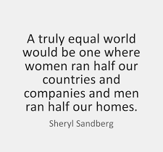
Ethics/Mission/Social Impact
Niagara seeks to inspire its students to serve all members of society, especially the poor and oppressed, in local communities and in the larger world.
Dignity of every person
Equality versus Equity
Power/Influence
Social Justice

