Slide 1
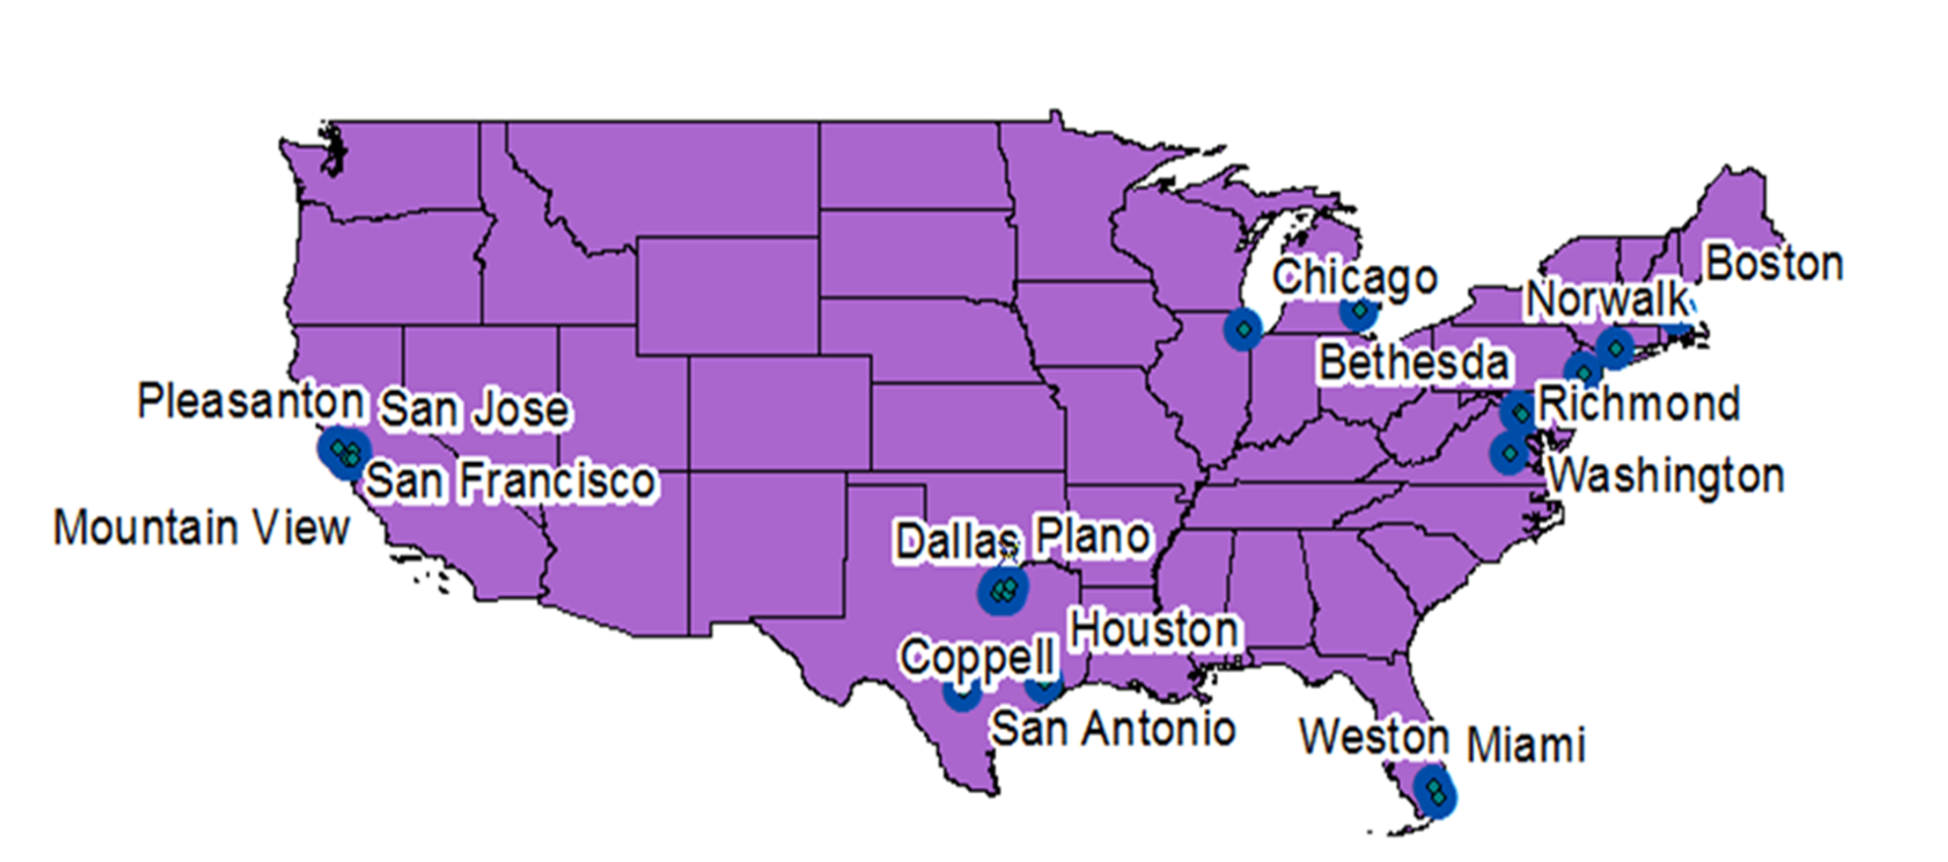
GIS Model Design Feminist Visualization Advancing Women
Kimberly DeSimone

Slide 2
Data Collection
Work-life-balance initiatives by company, state, and city.
Cities with the best diversity initiatives (by company, state, and city).
Best companies for working women based on (criteria) one of the largest is % of women executives
Highest paid women (C-Suite), state and salary
2015 Gender Pay Gap (percentage women make compared with men) by state
Top 20 Cities in America with the highest mean salaries for women

Slide 3
Model: Data Input & information Output
Gender pay data
Gender top earner data
Work-life-balance data
Diversity initiative data
Highest mean salary by gender
Map of top cities/states work-life balance initiatives
Map of top cities/states diversity initiatives
Map of gender pay gap & top earner data correlated
Map of correlated with
GIS
State
County
City

Slide 4
Data Collection Criteria/Methodology
Fortune & Forbes “best of the best” rankings
630 companies with published “Great Place to Work” reviews
128,000 women were surveyed and nearly 70,000 minorities at 630 companies answered a detailed questionnaire
Analyzed Glassdoor.com a social jobs and careers community where people share information and opinions about the places they work.
Interview feedback from more than 137,762 women
high representation in the total employee population and in management positions.
In statistical terms, the results from the survey are highly reliable, having a 95% confidence level and a margin of error of 6% or less.

Slide 5
Top Cities – Diversity Initiatives

Slide 6
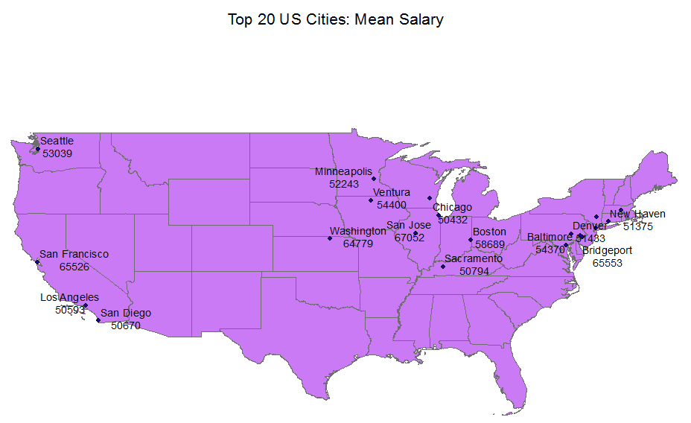

Slide 7
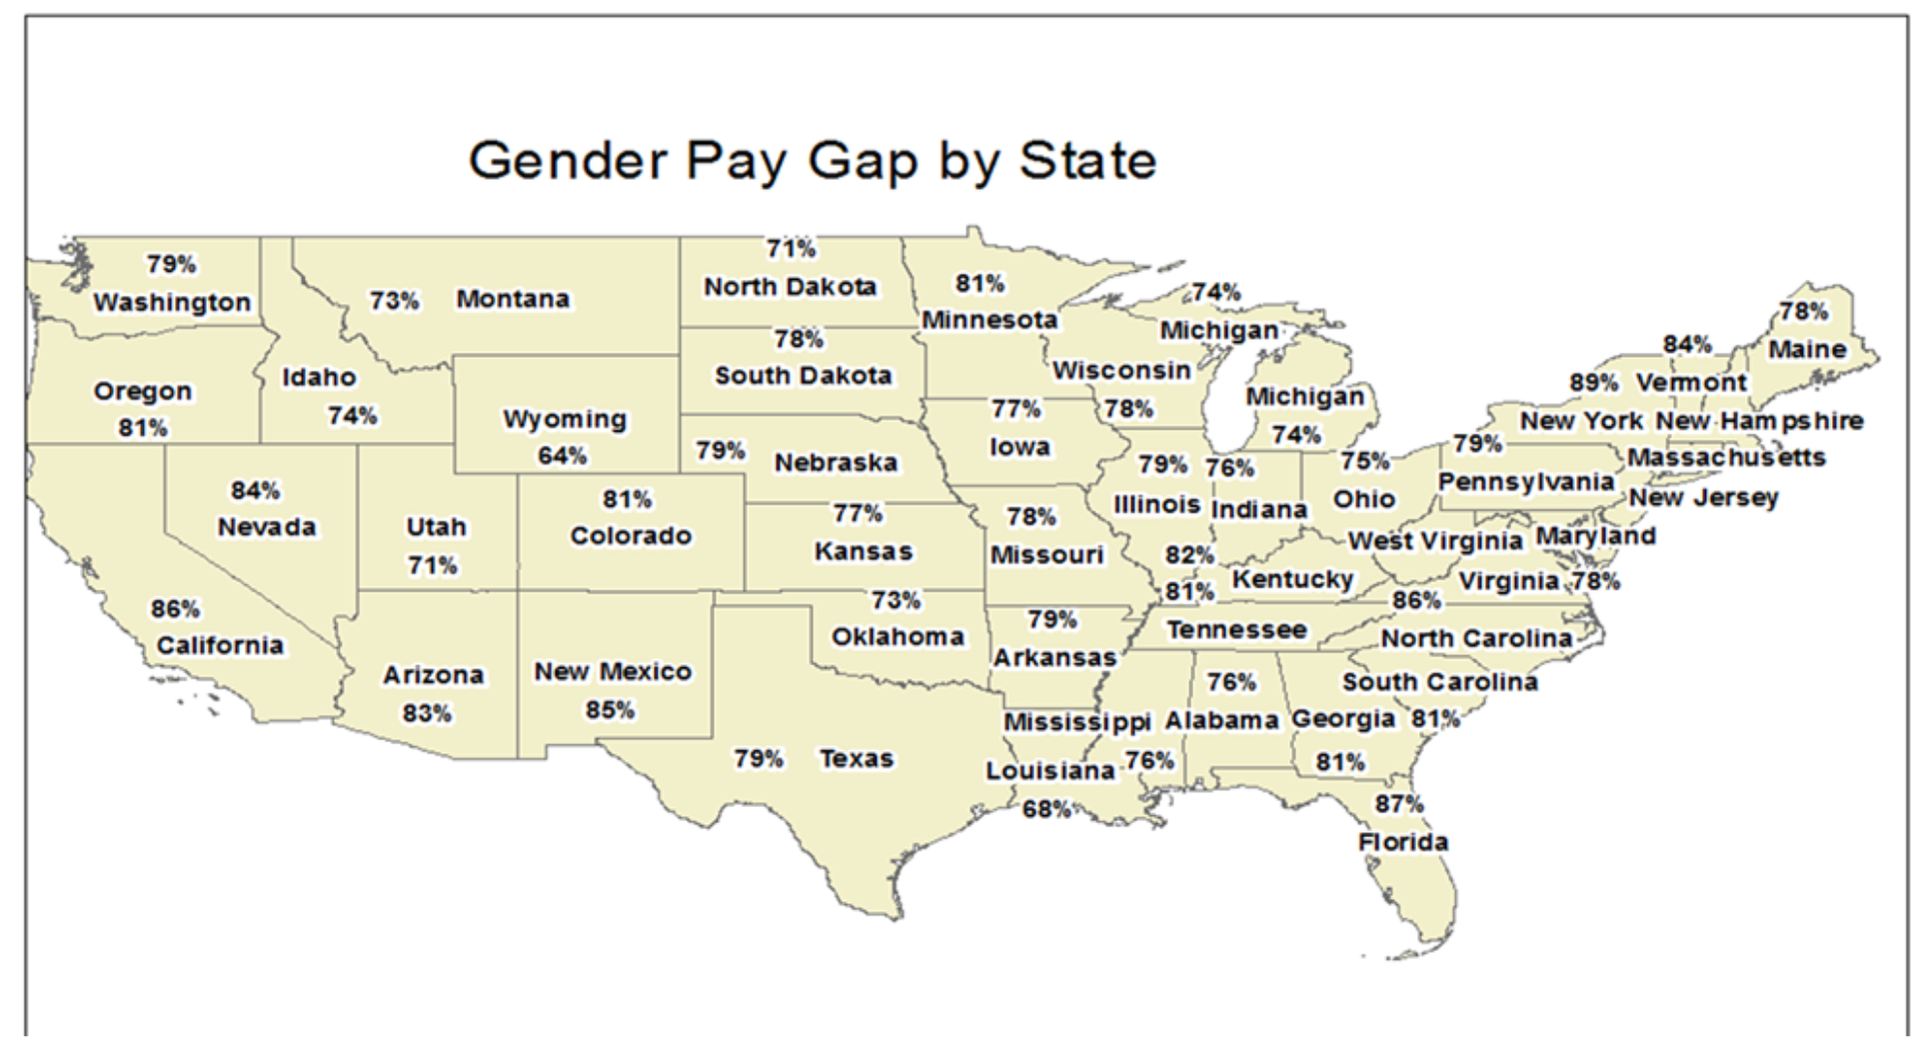

Slide 8
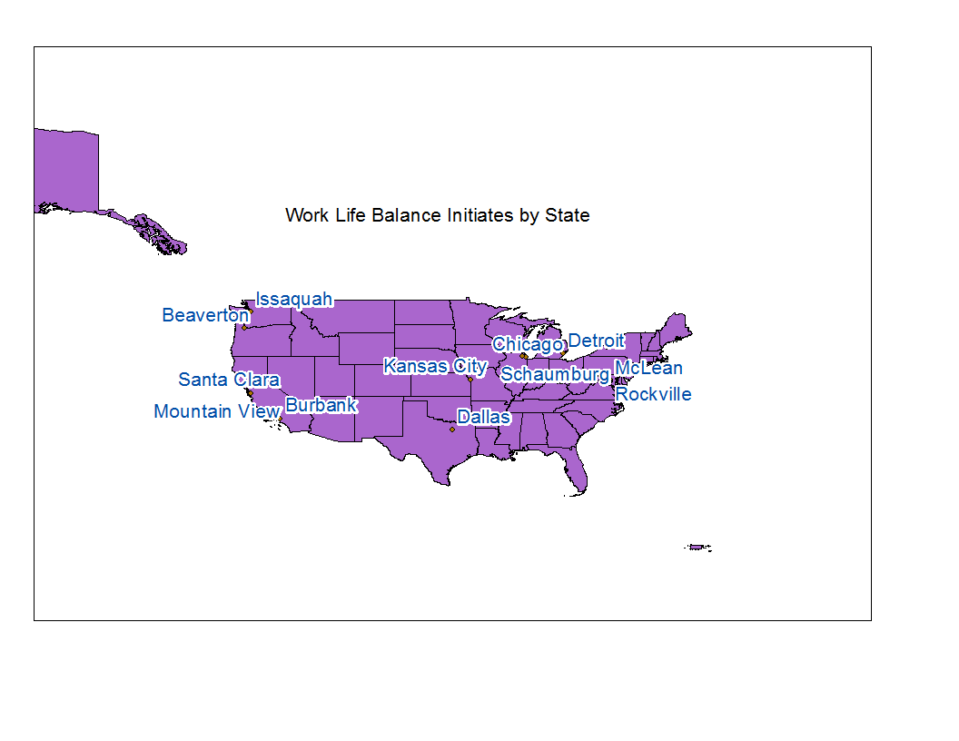

Slide 9
Results/Insights
Highly clustered geographic data in terms of women’s workforce success with the lowest pay gaps and highest mean salaries clustered in few geographic areas (mainly the northeast and southwest).
Diversity/PayGap/Mean Salary similar clusters
Work-life-balance initiatives don’t translate to salary as diversity issues do.
Almost half the states didn’t rank and two states dominated with New York and California showing the best women’s workforce condition. Manhatten and the “Sans” in California dominate. Bleak in the smaller cities, even in CA and NY.
Few companies on the list outside of NY and CA
Much Middle America showing intense need for improved gender inequity initiatives.

Slide 10
Future Research Opportunities
Correlations (layering maps)
Visual representation of the correlations between push and pull variables identified in the literature
Ex. pay gap and work-life-balance; diversity initiatives merged and layered with women’s actual representation and advancement outcome; work-life-balance initiatives by state, county and city for example, overlaid with resprentation by mean pay by state, county, and city, etc.
Opportunity to provide powerful insights for advocacy groups working towards elevating the significance of gender inequities in the workplace and fighting to allocate meaningful and efficacious resources.

