Slide 1
Liberate
Inspire
Facilitate
Empower

Slide 2
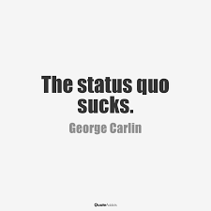
LIBERATE
Definition: release someone from a state or situation that limits freedom of thought or behavior
Postmodern (hegemony, power)
Feminist Theory - a “male-gendered and typically white male-dominated form of organization” (Hatch & Cunliffe, 2013, p. 119).
Disrupt/deconstruct the Status Quo
Diversity of Thinking

Slide 3
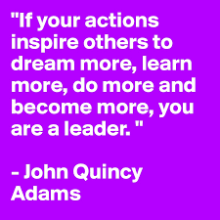
INSPIRE
“For people to follow someone willingly the leader must be inspiring” (Kouzes and Posner, 2012, p. 35)
Passion and purpose – Kouzes and Posner (2012) “feel your passion” (p. 114) “have a common purpose” (p. 116)
“Energy, optimism and hope” (p. 99)
”Inspire a shared vision” (p. 99)

Slide 4
FACILITATE
Definition: To make easier (facilitate, not frustrate)
Create an environment conducive to success
“Leaders foster collaboration by building trust and facilitating relationships” (p. 21)
“Foster collaboration, you can’t do it alone” Kouzes & Posner (2012 p. 238)
Walk the Talk (Kouzes & Posner, 2012) – give people the resources and tools to achieve and succeed in their way.
Facilitate change

Slide 5
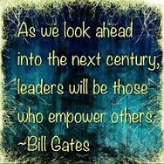
EMPOWER
Enable others to act (Kouzes and Posner, 2012, p. 21)
Transformational leadership, intrinsic motivation, and creativity
“Strengthen others” (p. 22)
You’re only as good as your people!
Free to challenge the process

Slide 6
How will YOU bring your leadership to
LIFE

